Slide 1



Slide 2



01CE1301 – Data Structure
Unit - 2
Linear Data Structure & their presentation
(Part 02 - Stack)
Prof. Chirag Bhalodia
Computer Engineering Department

Slide 3
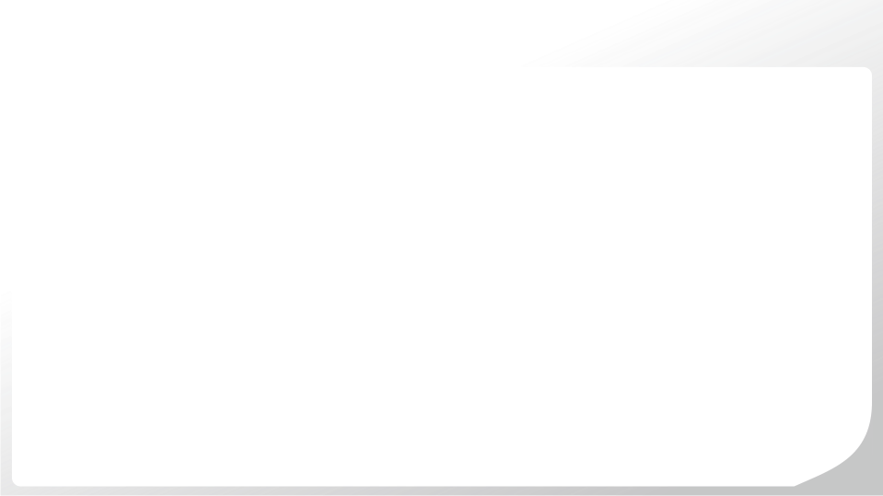
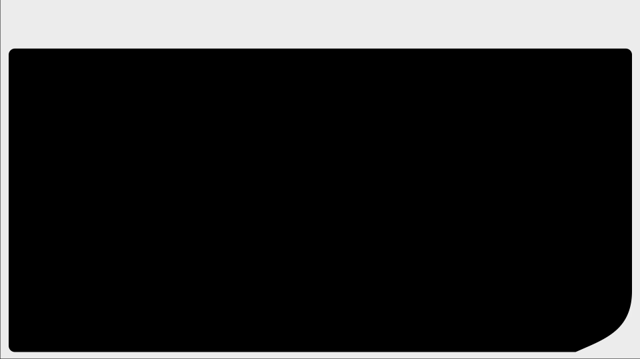
Outline
Stack definitions and concepts
Operations on stacks (push, pop, peep, change)
Polish Expressions and their compilation
Tower of Hanoi.

Slide 4

Stack Definition & Concepts

Slide 5
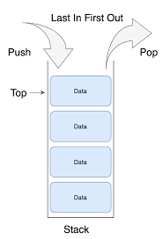
Stack Definitions & Concepts
A linear list which allows insertion and deletion of an element at one end only is called stack.
The insertion operation is called as PUSH and deletion operation as POP.
The most accessible elements in stack is known as top.
The elements can only be removed in the opposite orders from that in which they were added to the stack.
Such a linear list is referred to as a LIFO (Last In First Out) list.
A pointer TOP keeps track of the top element in the stack.
Initially, when the stack is empty, TOP has a value of “-1”.

Slide 6
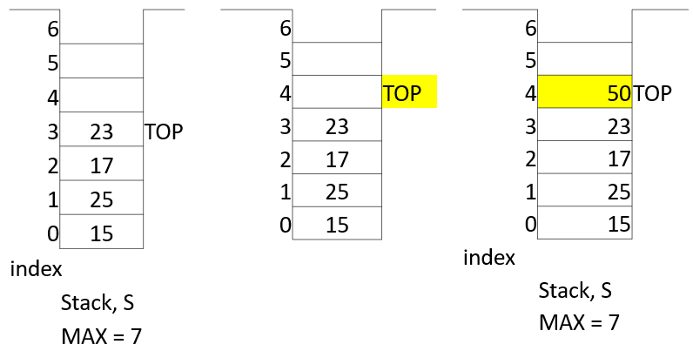
Stack Definitions & Concepts
Every stack has a variable TOP which is used to store the address of the topmost element of the stack.
Another variable MAX which is used to store the maximum number of elements that stack can hold.
If TOP = -1 then stack is Empty.
If TOP = MAX – 1 then stack is Full.

Slide 7
Function: PUSH (S, TOP, X)
This procedure inserts an element X to the top of a stack.
Stack is represented by a stack S containing N elements.
A pointer TOP represents the top element in the stack.
1. [Check for stack overflow]
If TOP ≥ N-1
Then write (‘STACK OVERFLOW’)
Return
2. [Increment TOP]
TOP ← TOP + 1
3. [Insert Element]
S[TOP] ← X
4. [Finished]
Return
Stack is empty, TOP = -1, N=3
PUSH(S, TOP, 10)
TOP = 2
-5
PUSH(S, TOP, 8)
TOP = 1
8
PUSH(S, TOP, -5)
TOP = 0
10
S
PUSH(S, TOP, 6)
Overflow

Slide 8
Function: POP (S, TOP)
This function removes & returns the top element from a stack.
Stack is represented by a stack S containing N elements.
A pointer TOP represents the top element in the stack.
1. [Check for stack underflow]
If TOP = -1
Then write (‘STACK UNDERFLOW’)
Return (0)
2. [Decrement TOP]
TOP ← TOP - 1
3. [Return former top element of stack]
Return(S[TOP + 1])
POP(S, TOP)
TOP = 2
-5
POP(S, TOP)
TOP = 1
8
TOP = 0
10
POP(S, TOP)
TOP = -1
S
POP(S, TOP)
Underflow

Slide 9
Function: PEEK/PEEP (S, TOP)
This function returns the value from the TOP of the stack. The element is not deleted by this function.
Stack is represented by a stack S containing N elements.
1. [Check for stack underflow]
If TOP = -1
Then write (‘STACK UNDERFLOW’)
Return (0)
2. [Return element from top of the stack]
Return(S[TOP])
PEEP (S, TOP)
-5
TOP = 2
-5
8
10
S

Slide 10
Function: SEARCH (S, TOP, I)
This function returns the value of the Ith element from the TOP of the stack. The element is not deleted by this function.
Stack is represented by a stack S containing N elements.
1. [Check for stack underflow]
If TOP-I+1 < 0
Then write (‘STACK UNDERFLOW’)
Return (0)
2. [Return Ith element from top of the stack]
Return(S[TOP–I+1])
SEARCH (S, TOP, 2)
TOP = 2
-5
8
8
SEARCH (S, TOP, 3)
10
10
S
SEARCH (S, TOP, 4)
Underflow

Slide 11
Function: CHANGE (S, TOP, X, I)
This procedure changes the value of the Ith element from the top of the stack to X.
Stack is represented by a stack S containing N elements.
1. [Check for stack underflow]
If TOP-I+1 < 0
Then write (‘STACK UNDERFLOW’)
Return
2. [Change Ith element from top
of the stack]
S[TOP–I+1] ← X
3. [Finished]
Return
CHANGE (S, TOP, 50, 2)
CHANGE (S, TOP, 9, 3)
CHANGE (S, TOP, 25, 8)
Underflow
TOP = 2
-5
8
50
10
9
S

Slide 12
Polish Expression & their Compilation

Slide 13
Introduction of Polish Expression
The order of evaluation of a postfix and prefix expression is always from left to right.
A repeated scanning from left to right is needed as operators appears inside the operands.
Prefix Expression: Operator, Operand, Operand
Postfix Expression: Operand, Operand, Operator
Evaluating Infix Expression
a + b * c + d * e
Notation | Example
Infix | A + B
Prefix / Polish Notation | + A B
Postfix / Reverse Polish Notation | A B +
1
2
3
4

Slide 14
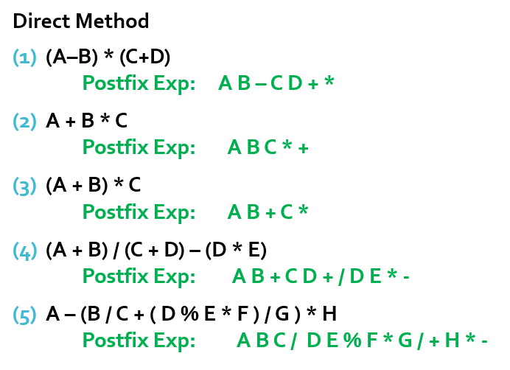
Reverse Polish Notation

Slide 15
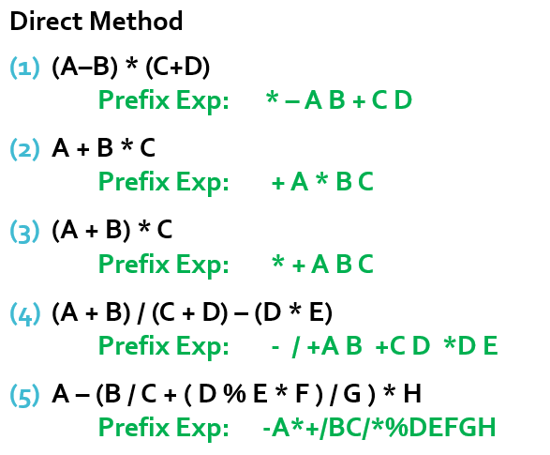
Polish Notation

Slide 16
Infix to postfix algorithm
Step 1: Add “)” to the end of the infix expression
Step 2: Push “(“ on to the stack
Step 3: Repeat until each character in the infix expression is scanned
(i) If operand, add it to the postfix expression
(ii) If “(“ , push it on the stack
(iii) If “)” then:
(a) Repeatedly pop from stack and add each operator to postfix expression until “(” is encountered.
(b) Discard the “(“. Remove “(“ from stack and don’t add it to the postfix expression.
(iv) If an operator ‘O’ is encountered. then:
(a) If precedence of operator at top of stack is higher or same as compare to ‘O’ then repeatedly it is popped and add to postfix expression.
(b) Push the operator O to the stack.
Step 4: Exit.

Slide 17
Infix to postfix algorithm
Note:
If any operator has Right to Left associativity And
if the precedence of operator at top of stack is SAME as compare to coming infix operator then
push it on the Stack, don’t pop it.
Exponentiation (power) is the highest level of precedence and Right to Left associativity.
Symbol: ^ $ ↑
(Different books use different symbol for the exponentiation.)

Slide 18
Exercise
(A+B)*(C*D-E)*F/G
( ( A – ( B + C ) ) * D ) / ( E * F )
A / B $ C + D * E / F – G + H
( A + B ^ D ) / ( E – F ) + G
A + B ^ C ^ D – E * F / G
A + B – C * D * E $ F $ G
A $ B – C * D + E $ F / G
A + B ^ C - D ^ E * F / G

Slide 19
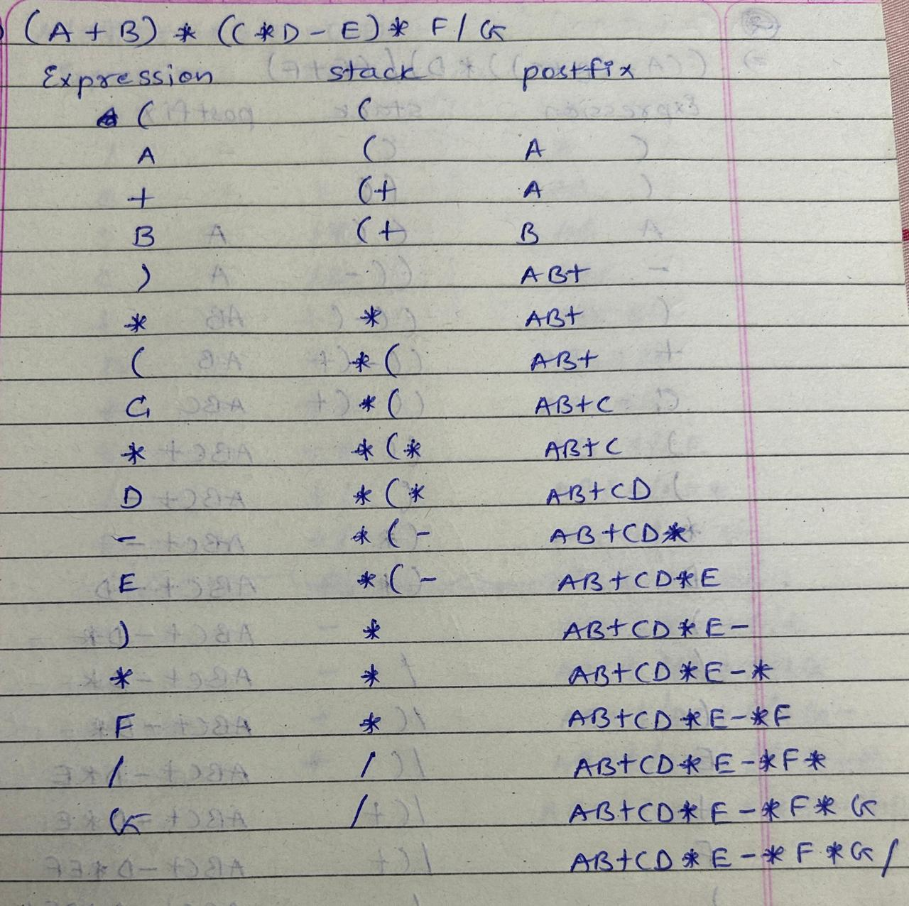
Infix to postfix using stack
Example
(A+B)*(C*D-E)*F/G

Slide 20
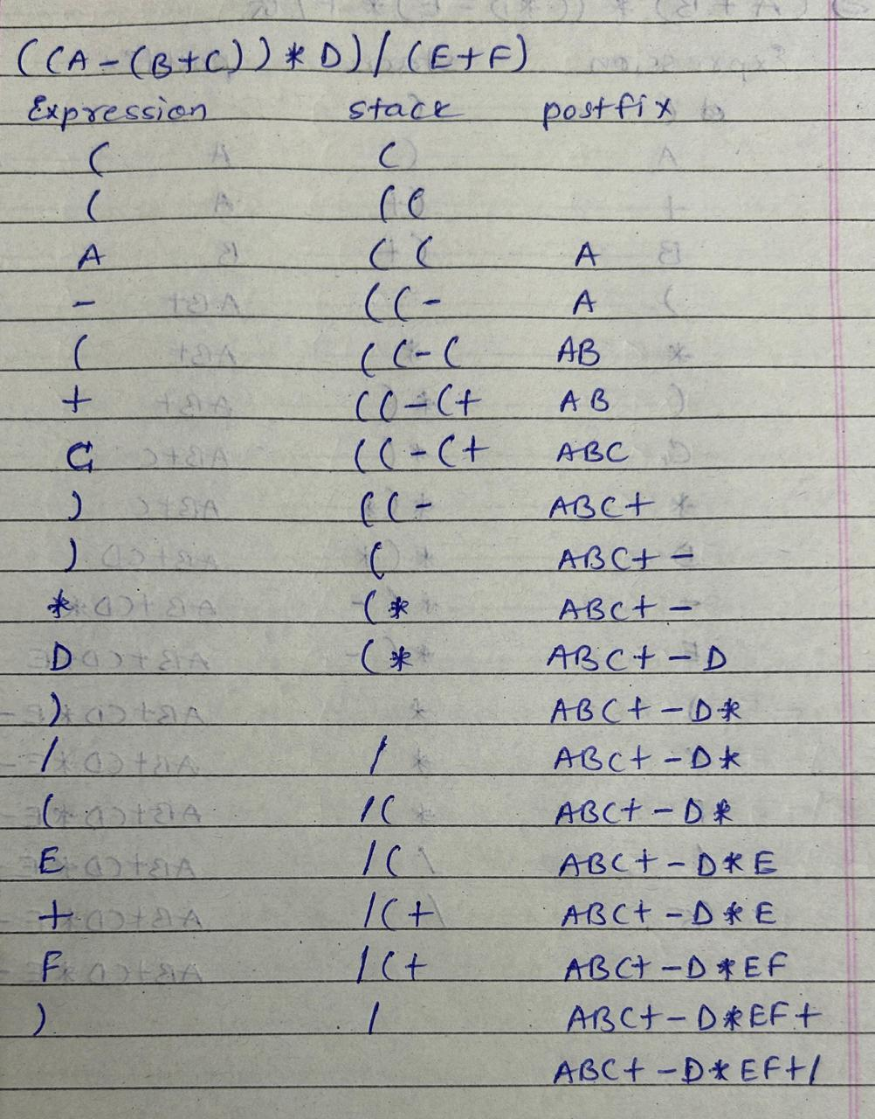
Infix to postfix using stack
Example
( ( A – ( B + C ) ) * D ) / ( E + F )

Slide 21
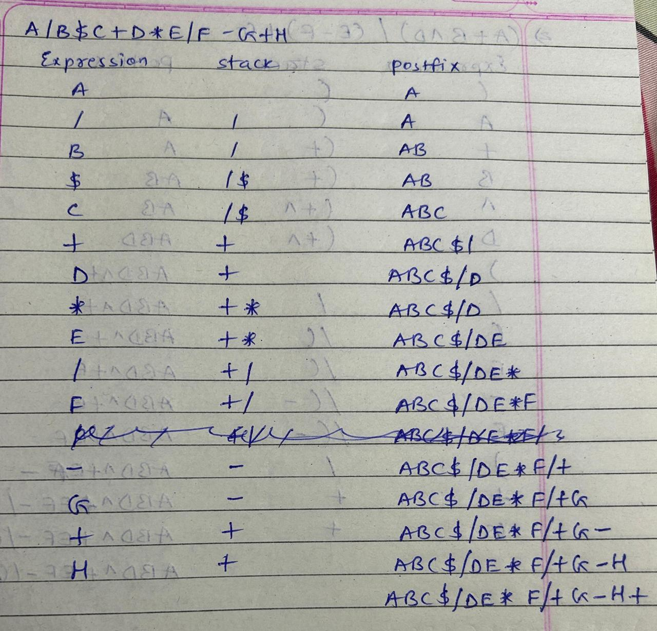
Infix to postfix using stack
Example
A / B $ C + D * E / F – G + H

Slide 22
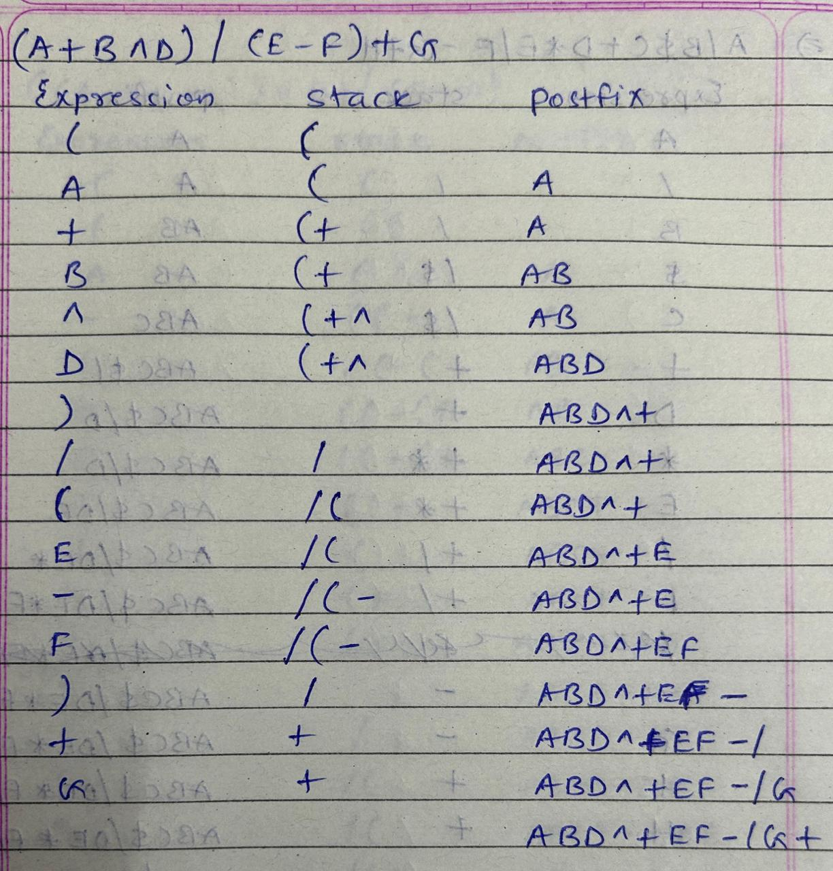
Infix to postfix using stack
Example
( A + B ^ D ) / ( E – F ) + G

Slide 23
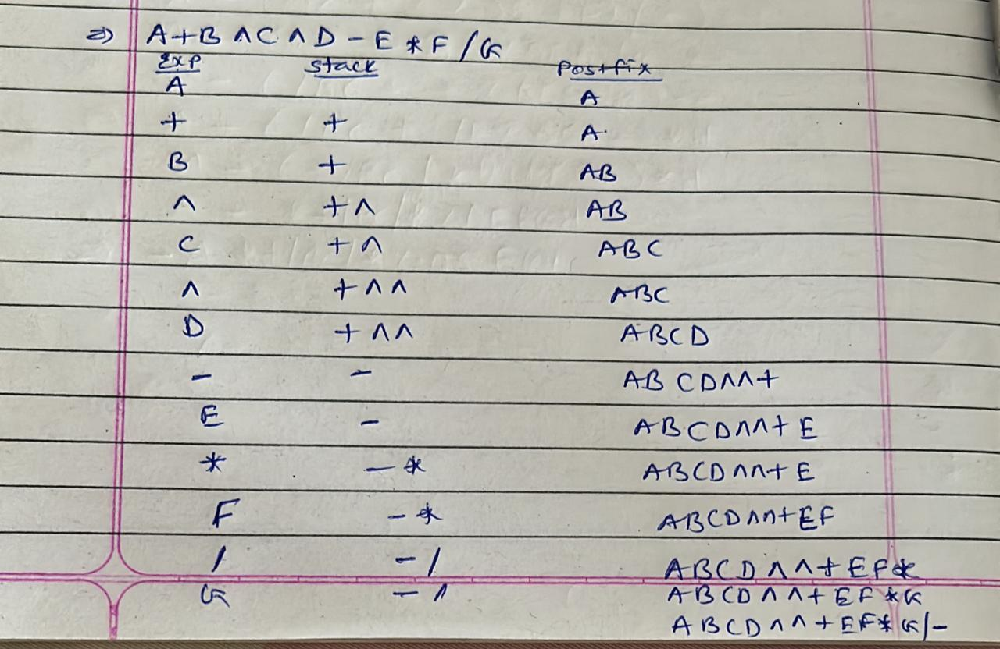
Infix to postfix using stack
Example
A + B ^ C ^ D - E * F / G

Slide 24
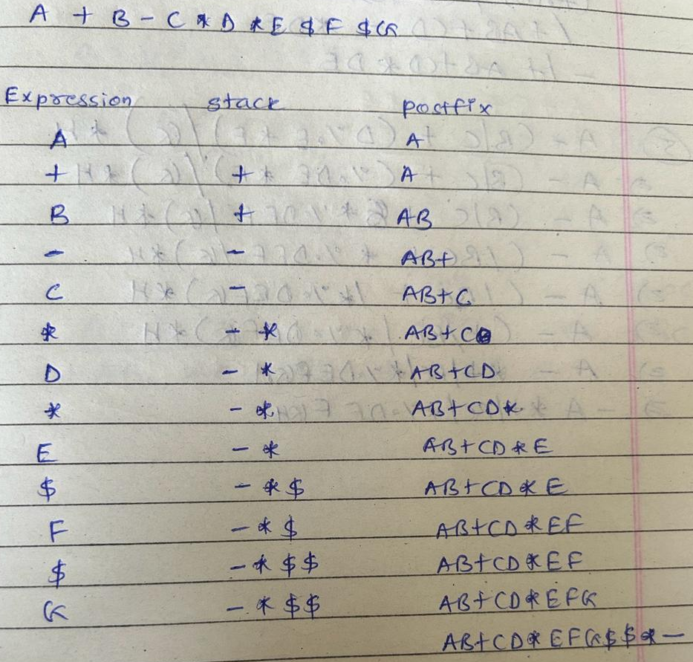
Infix to postfix using stack
Example
A + B – C * D * E $ F $ G

Slide 25
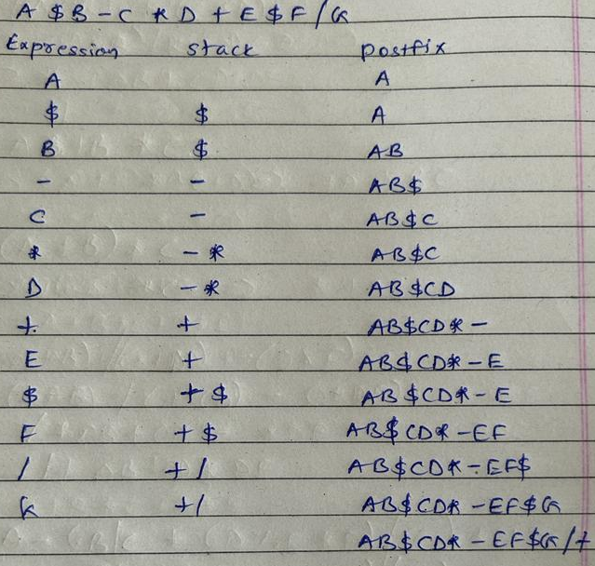
Infix to postfix using stack
Example
A $ B – C * D + E $ F / G

Slide 26
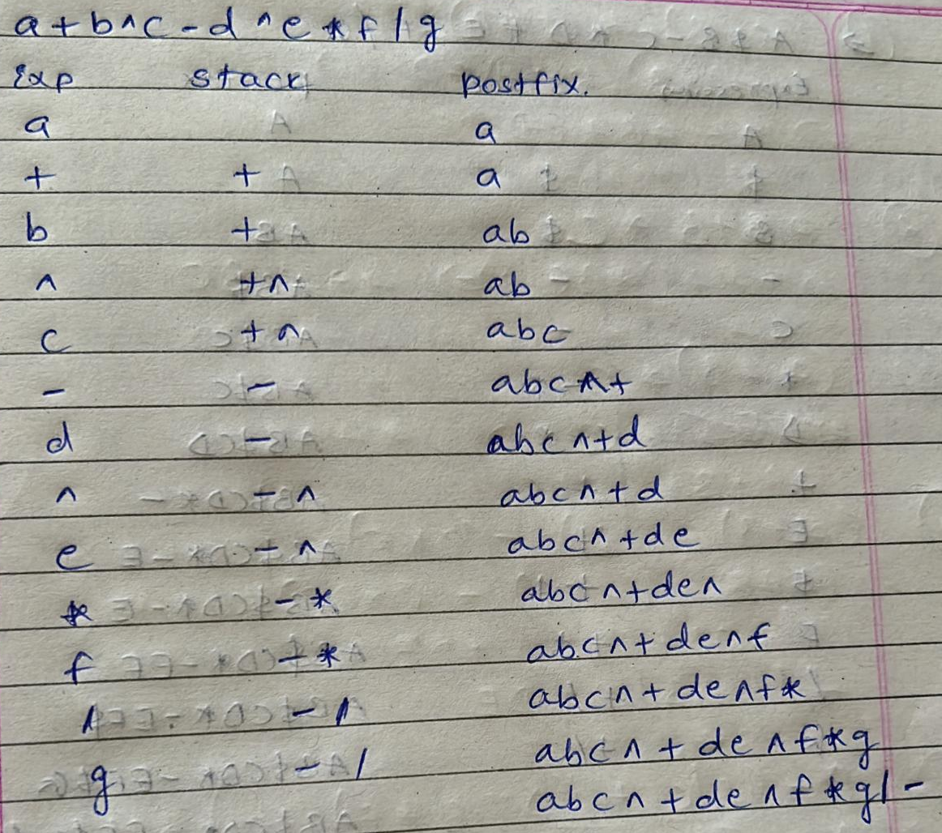
Infix to postfix using stack
Example
A + B ^ C - D ^ E * F / G

Slide 27
Infix to prefix algorithm
Step 1: Reverse the infix string (Interchange parenthesis)
Step 2: Convert infix exp. to postfix exp.
Step 3: Reverse the postfix exp.
Step 4: Exit
Note: When Pushing operator, follow the rules of Right to Left associativity because we started from Right side (reverse the string)

Slide 28
Exercise
(A+B)*(C*D-E)*F/G
( ( A – ( B + C ) ) * D ) / ( E * F )
A / B $ C + D * E / F – G + H
( A + B ^ D ) / ( E – F ) + G
A + B ^ C ^ D – E * F / G
A + B – C * D * E $ F $ G
A $ B – C * D + E $ F / G
A + B ^ C - D ^ E * F / G

Slide 29
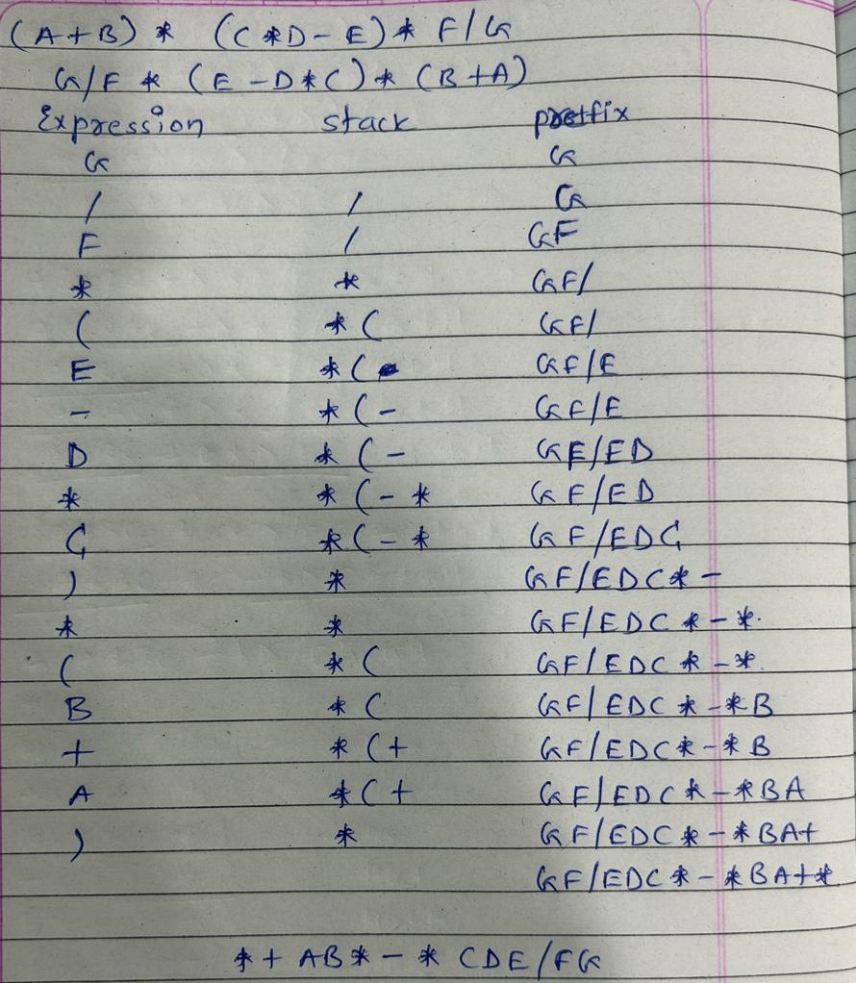
Infix to prefix using stack
Example
(A+B)*(C*D-E)*F/G

Slide 30
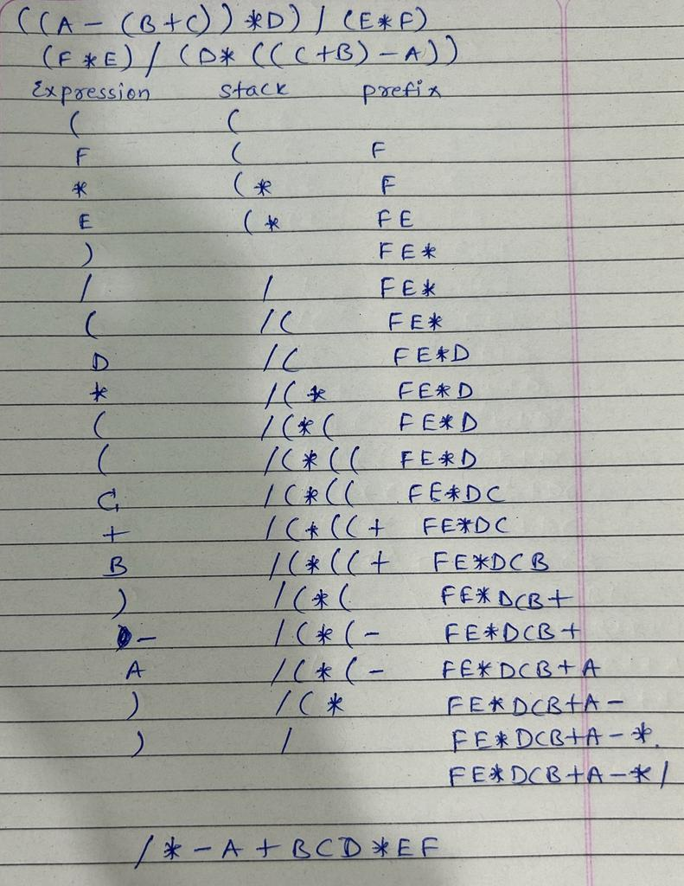
Infix to prefix using stack
Example
( ( A – ( B + C ) ) * D ) / ( E * F )

Slide 31
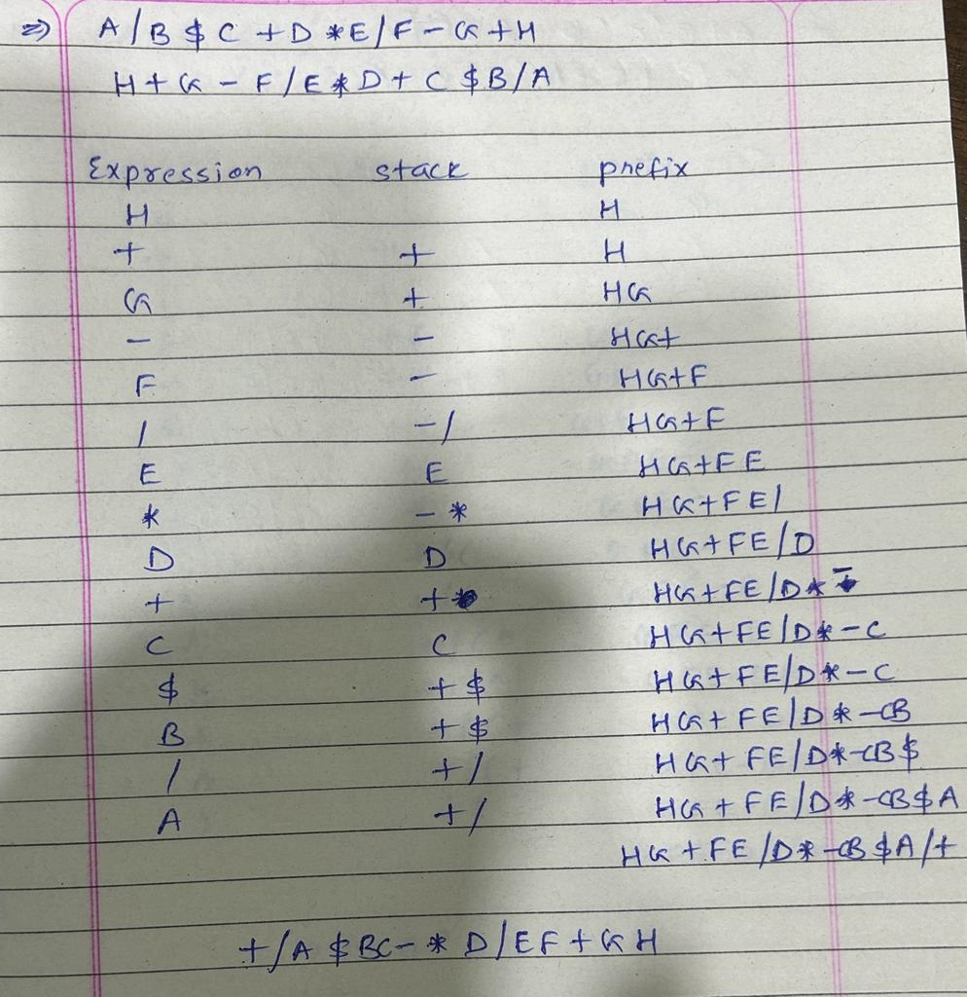
Infix to prefix using stack
Example
A / B $ C + D * E / F – G + H

Slide 32
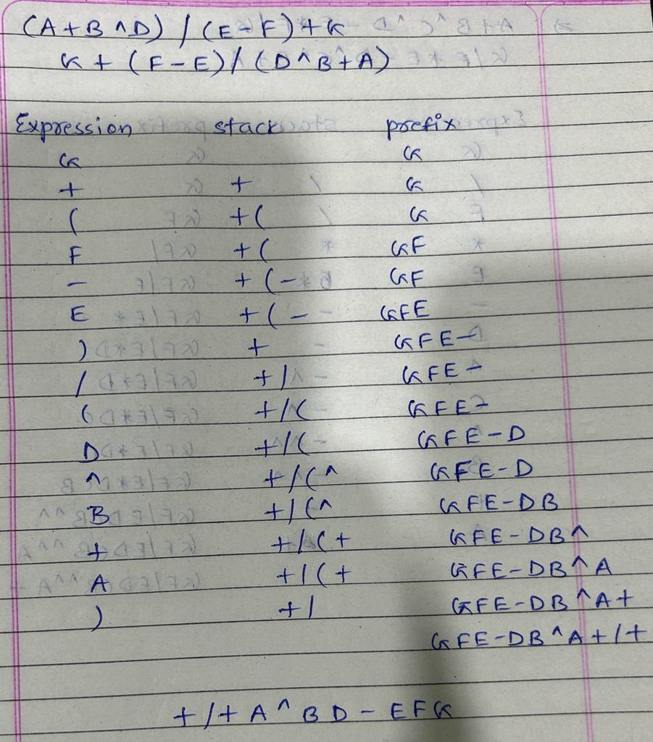
Infix to prefix using stack
Example
( A + B ^ D ) / ( E – F ) + G

Slide 33
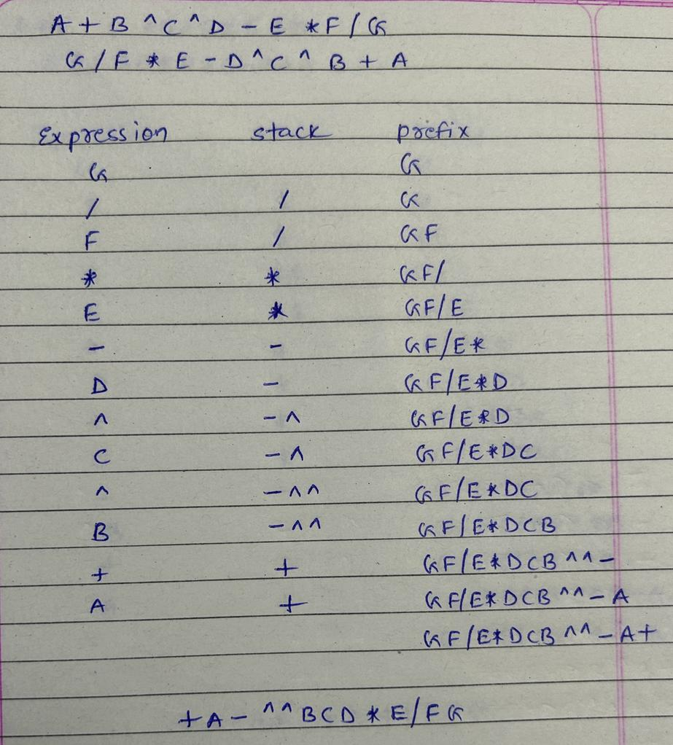
Infix to prefix using stack
Example
A + B ^ C ^ D - E * F / G

Slide 34
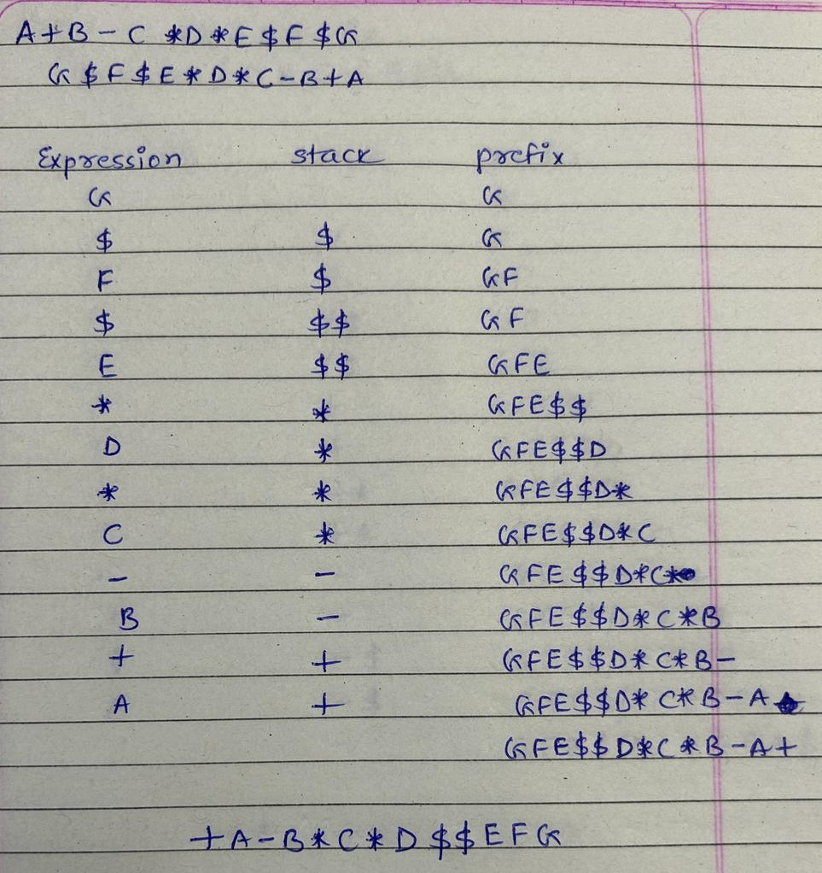
Infix to prefix using stack
Example
A + B – C * D * E $ F $ G

Slide 35
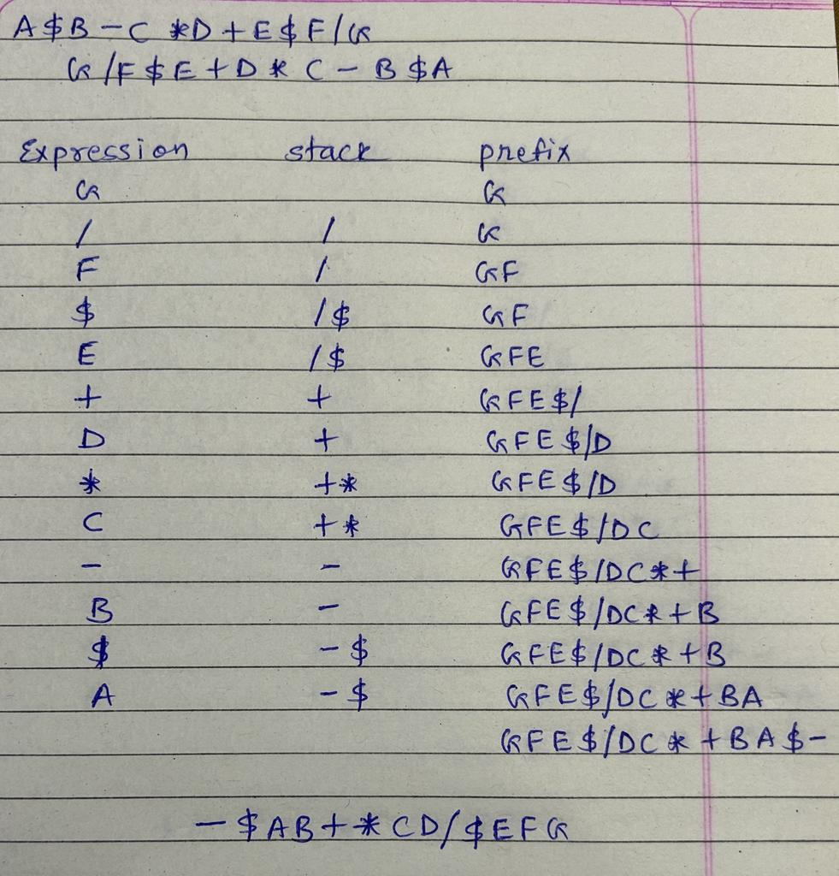
Infix to prefix using stack
Example
A $ B – C * D + E $ F / G

Slide 36
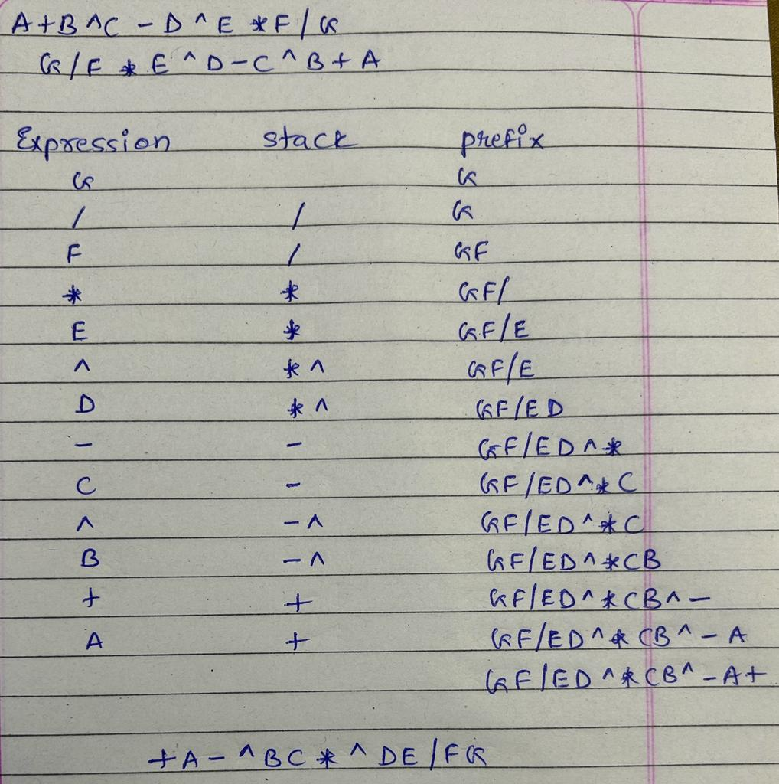
Infix to prefix using stack
Example
A + B ^ C - D ^ E * F / G

Slide 37
Application of Stack
Recursion
Keeping track of function calls
Evaluation of expressions
Reversing characters
Expression Conversion (Infix to Postfix, Infix to Prefix)
Microsoft Word (Undo / Redo)
Compiler – Parsing syntax & expression
Finding paths

Slide 38
Tower of Hanoi

Slide 39
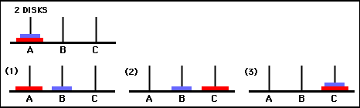
Tower of Hanoi
If n = 2, means src (A) is having 2 disks to be moved over destination (C) using spare (B)
move (2, A, C, B)
move (1, A, B, C); [A→ B]
move (1, A, C, B); [A→ C]
move (1, B, C, A); [B → C]

Slide 40
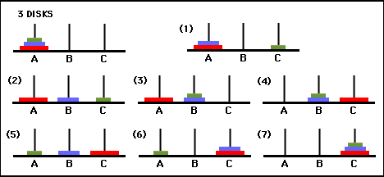
Tower of Hanoi
If n = 3, means src (A) is having 3 disks to be moved over destination (C) using spare (B)
move (3, A, C, B)
move (1, A, C, B); [A→C]
move (2, A, B, C); move (1, A, B, C); [A→B]
move (1, C, B, A); [C→B]
move (1, A, C, B); [A→ C]
move (1, B, A, C); [B→A]
move (2, B, C, A); move (1, B, C, A); [B→C]
move (1, A, C, B); [A→C]

Slide 41

Thank
You

